Slide 1
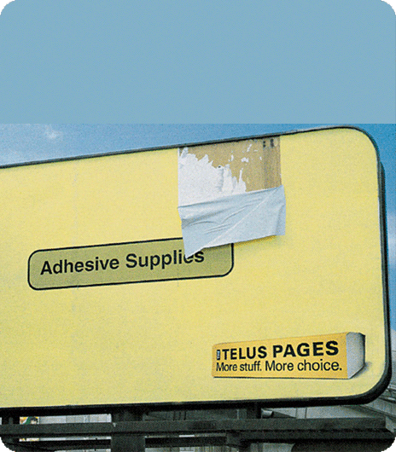

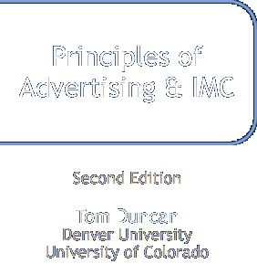
Advertising and IMC Media Planning
For use only with Duncan texts. © 2005 McGraw-Hill Companies, Inc. McGraw-Hill/Irwin
Notes:
Chapter 1
Using Advertising and Promotion to Build Brands
For use only with Duncan texts. © 2005 McGraw-Hill Companies, Inc. McGraw-Hill/Irwin

Slide 2
Chapter Outline
What are the steps in the media planning process?
What is the difference between reach and frequency?
How do you determine a media mix?
What role does cost play in selecting media?
What factors are involved in scheduling media?

Slide 3


Chapter Perspective
Media are the bridge that connects…
Organizations
Consumers

Slide 4
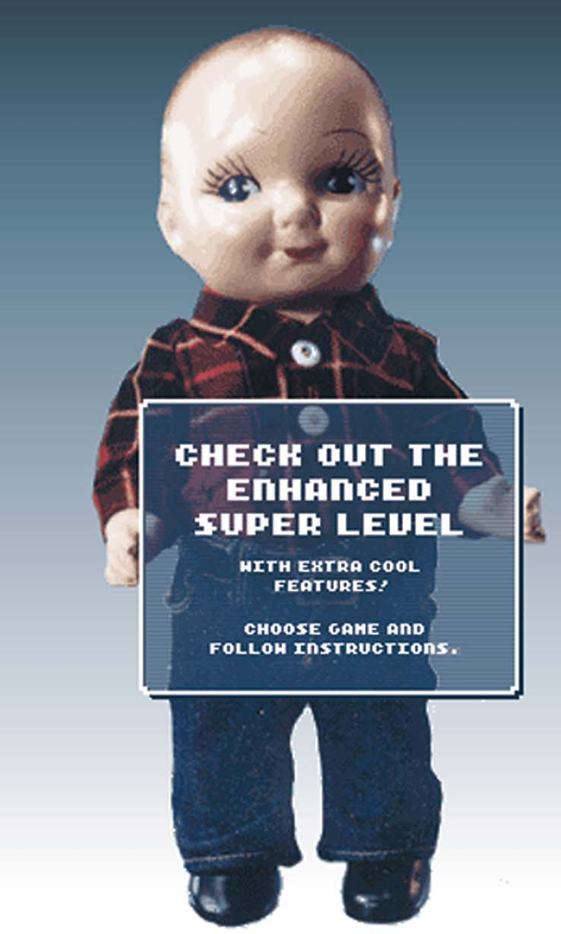
Opening Case: Lee Jeans

Slide 5
Opening Case: Lee Jeans
Update a “boring” brand
Challenge:
Update a “boring” brand
An IMC program featuring:
The “Buddy Lee” theme, with:
initial phase of guerilla marketing tactics
two-part series of three-minute short films
ads on FOX, WB, ESPN 2, MTV, VH1, E!
An IMC program featuring:
The “Buddy Lee” theme, with:
initial phase of guerilla marketing tactics
two-part series of three-minute short films
ads on FOX, WB, ESPN 2, MTV, VH1, E!
Answer:
Buddy Lee has become a bona fide pop-culture icon
“cool to wear" score moved from 26% to 35%
3 percent market share growth
Results:

Slide 6


Media Planning
Media planning: A process for determining the most cost-effective mix of media for achieving a set of media objectives
  Goal: maximize impact while minimizing cost
  Media is often the largest MC budget item

Slide 7
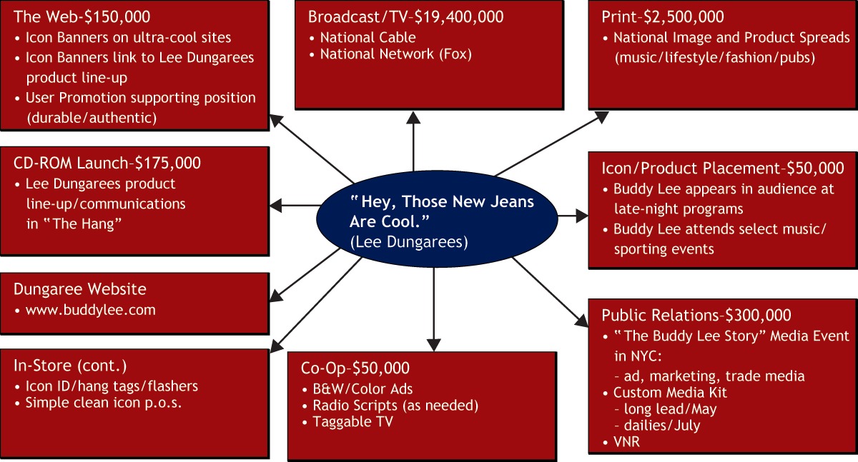
Figure 13-1: Lee Dungarees Media Mix
+

Slide 8
The Basics
  Media research
  Analyzing target audiences and media options
  Media research
  Analyzing target audiences and media options
Media planning
Process of developing a good media plan
Media planning
Process of developing a good media plan
  Media buying
  Execution of a media plan

Slide 9
What Are The Media Planning Steps?
Step 1: Media targeting
Planning
Steps

Slide 10
MRI Data Indicating Media Usage Skews
Category A B C D
(000) Horiz.% Vert.% Index
College Students 15,136 7.46 100 100
Men 7,182 7.39 47.45 99
Women 7,954 7.53 52.55 101
Magazines
Allure 883 19.19 5.83 257
Boating 176 5.88 1.16 79
Bride’s 1064 16.64 7.03 223
Glamour 1910 16.09 12.62 216
Maxim 2604 26.33 17.20 353
Outdoor Life 460 6.67 3.04 89
Time 2363 10.31 15.62 138
Wall Street Journal 364 9.60 2.40 129

Slide 11


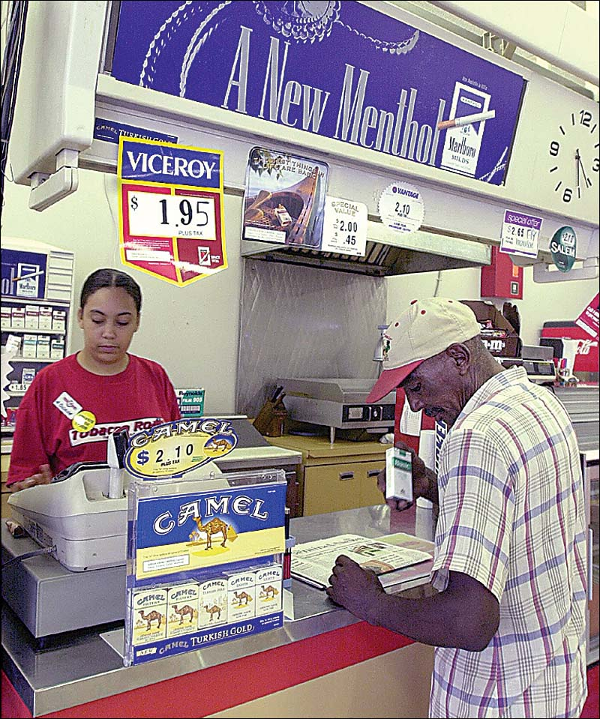
Think About It
Do you think all cigarette advertising should be pulled from magazines like Glamour, People, Newsweek, and Rolling Stone?

Slide 12
What Are The Media Planning Steps?
Step 1: Media targeting
Step 1: Media targeting
Planning
Steps
Step 2: Determining media objectives

Slide 13
Reach
Reach: The percentage of an
audience that has had the
opportunity to be exposed to a
media vehicle within a specified
period of time
    Ideal goal: 100% reach

Slide 14
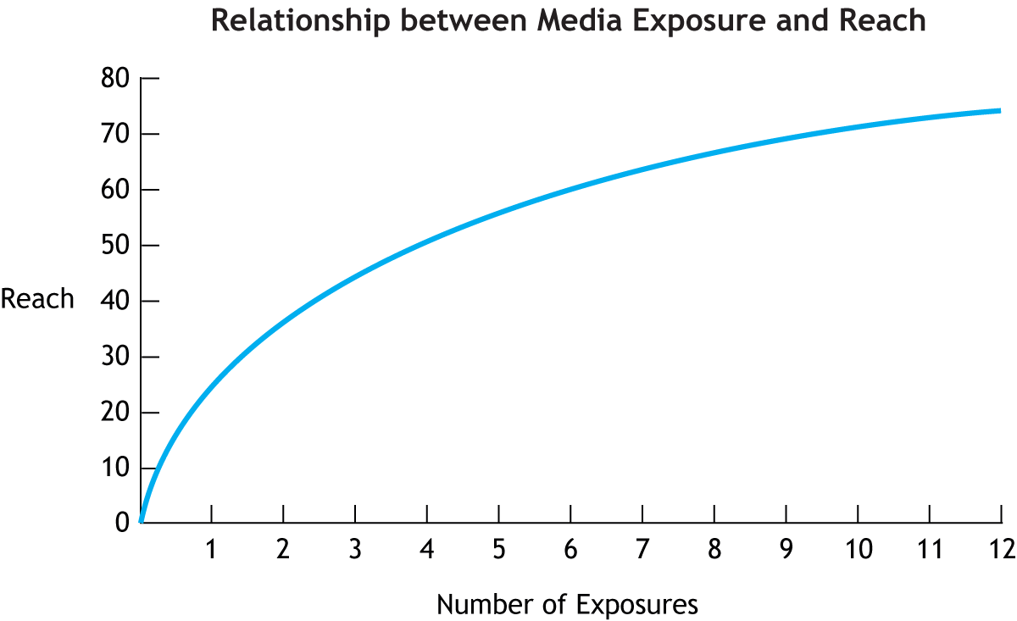
Figure 13-4: As Shown, it is Difficult to Achieve 100% Reach

Slide 15
Frequency
Frequency: The average number of times those who are reached have an opportunity to be exposed to a brand message within a specified time period
  Frequency to be effective: 3-10 exposures
  Varies widely by brand

Slide 16
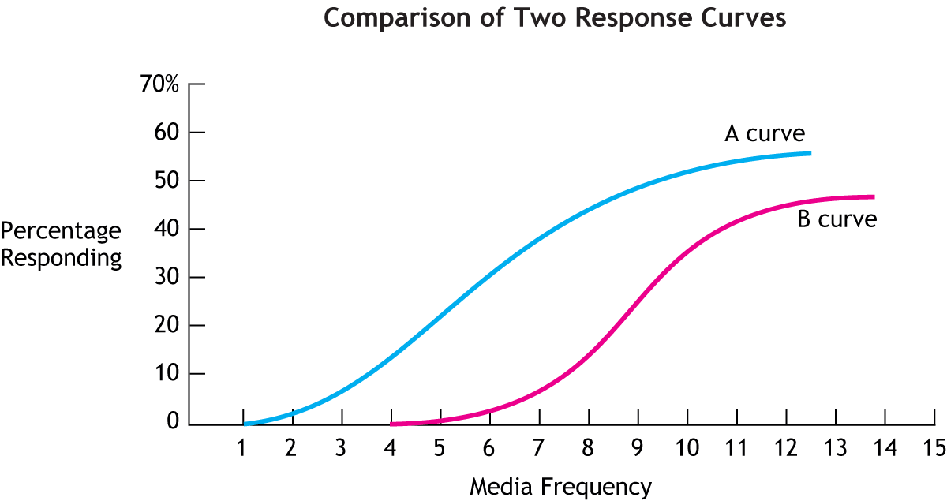
Figure 13-5: The “A” Curve is More Desirable Because its Effective Frequency is Less than “B”

Slide 17
Gross Rating Points (GRPs)
Gross Rating Points (GRPs):
The combined measure of reach and frequency indicating the weight of a media plan
  The more GRPs, the more “weight” a plan has

Slide 18
The Simple Formula to Calculate GRPs
Gross Rating Points (GRPs) = Reach x Frequency
Print example
50 reach X 5 insertions = 250 GRPs
Broadcast example
6 (rating) X 5 (frequency) = 30 GRPs

Slide 19
Total Number of GRPs Delivered by a National TV Media Plan
Programs Program Rating Frequency GRPs
CBS Evening News 6 x 5 = 30
Friends 10 x 4 = 40
Law & Order 15 x 6 = 90
Monday Night Football 12 x 3 = 36
Total 196

Slide 20
What Are The Media Planning Steps?
Step 1: Media targeting
Step 1: Media targeting
Planning
Steps
Step 2: Determining media objectives
Step 2: Determining media objectives
Step 3: Determining media strategies

Slide 21
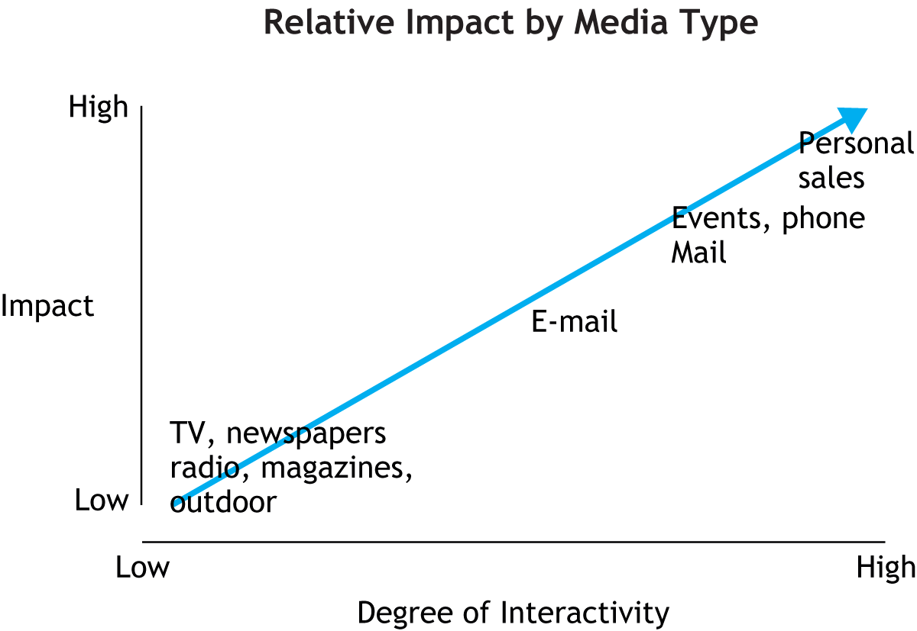
Figure 13-6: Some Products Will Require More Interactive Media to Gain Impact

Slide 22


Insight: Media Mix Habits
Many organizations use one or two media simply out of tradition. This happens most often with the use of magazine and TV. These media are often seen as the most “glamorous” of the various MC tools. Most marketers prefer to identify themselves with a TV or magazine advertising campaign rather than with a direct-marketing campaign.

Slide 23
Determining Media Cost
Cost per thousand (CPM):
What a communication vehicle charges to deliver a message to 1,000 members of its audience
  Used commonly for print media
Cost of ad unit X 1,000 = CPM
Circulation or audience

Slide 24
How Does Cost Affect Media Selection?
Magazine A Magazine B
Cost of a
Full Page Ad:
$20,000
$20,000
$30,000
$30,000
800,000
800,000
1,500,000
Circulation:
1,500,000
$20,000 x 1,000
800,000
$30,000 x 1,000
1,500,000
CPM:
= $25
= $20

Slide 25
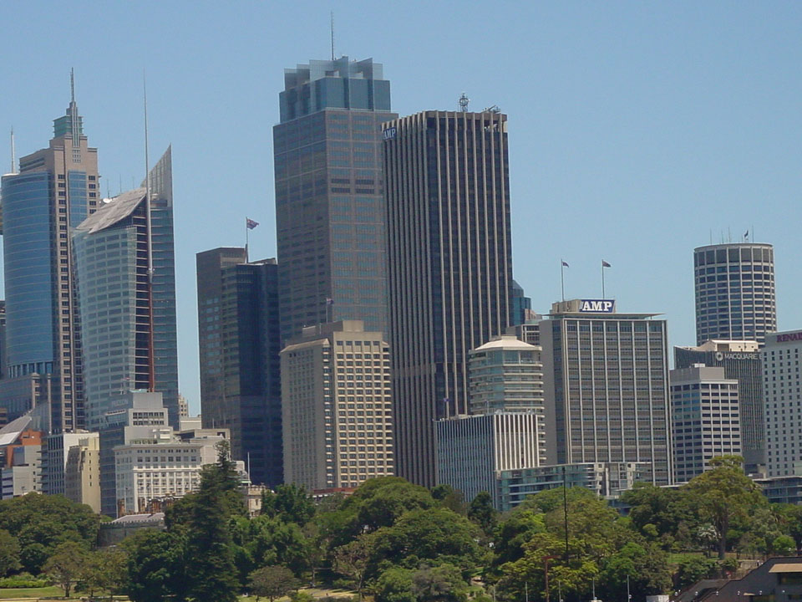

Tales From the Real World
The term “CPM” is often confusing for students. Unless you took Latin in high school, you wouldn’t guess that CPM stands for “Cost per Thousand.”
The chapter explains that the “M” in CPM is the Roman numeral for 1,000, but in the real world, many professionals still aren’t sure. Unfortunately for them, most media sales people use this term in quoting prices for their media. Which suggests another Latin term: caveat emptor.

Slide 26
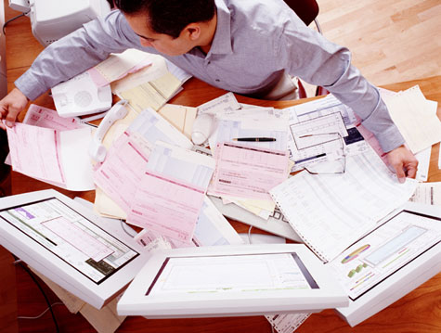
IMC In Action: Optimizer Programs

Slide 27
IMC In Action: Optimizer Programs
How to create the best media mix
Challenge:
How to create the best media mix
Optimizer programs:
Complex media planning models that combine ratings data with other data from in-store scanners and customer profile databases
Optimizer programs:
Complex media planning models that combine ratings data with other data from in-store scanners and customer profile databases
Answer:
The programs can determine whether ER viewers purchase more cosmetics, soft drinks, or pain remedies than the viewers of Frasier
Results:

Slide 28
What Are The Media Planning Steps?
Step 1: Media targeting
Step 1: Media targeting
Planning
Steps
Step 2: Determining media objectives
Step 2: Determining media objectives
Step 3: Determining media strategies
Step 3: Determining media strategies
Step 4: Determining media Scheduling

Slide 29
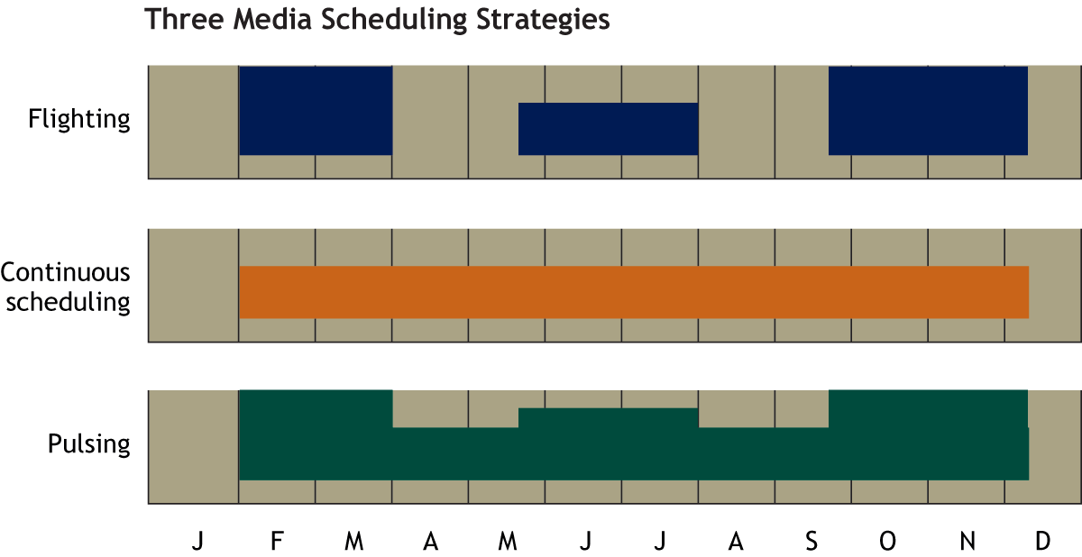
Figure 13-7: Most Organizations Use One of These Three Scheduling Strategies

Slide 30
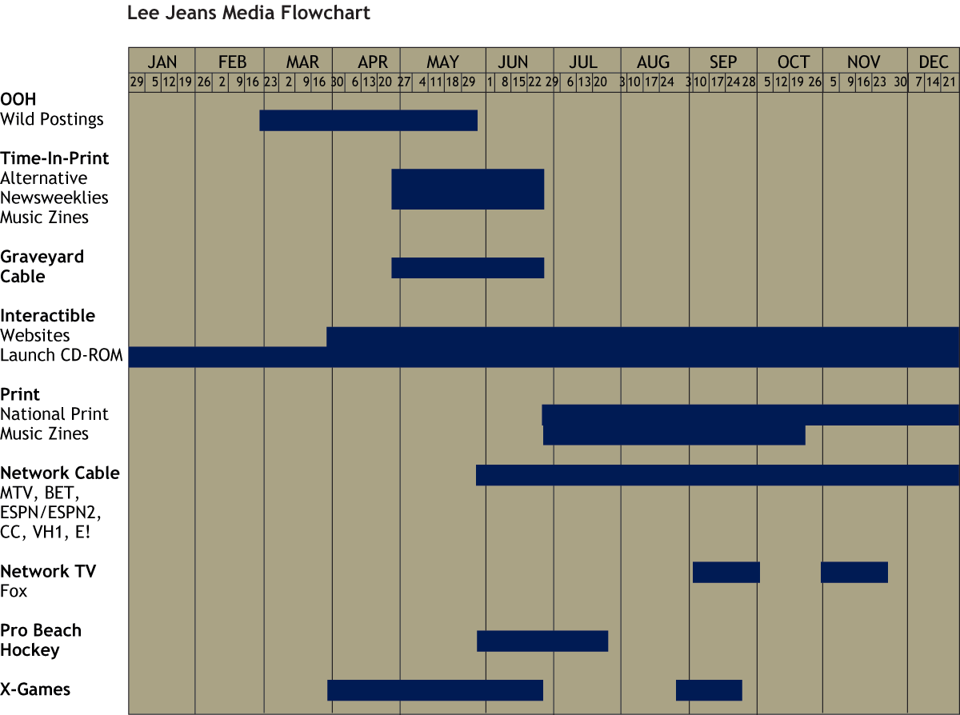
Figure 13-8: An Example of a Media Schedule

Slide 31
Final Note:
Media scheduling and other elements
of the brand offering (packaging, publicity releases, etc.) must be integrated so that a company does not miss opportunities for reaching the right audiences, at the right time, in dynamic ways
A bad scenario: the media schedule begins running before the product is available

