Slide 1

Predictive Analytics 101
Predictive Analytics:
How It Works and How to Deploy It
Dr. Jamie Pleasant
Clark Atlanta Univ.

Slide 2
What is Predictive Analytics?
A modeling tool that produces a predictive score for each customer’s future behavior
It reduces the data mining effort vs large to small management of data acquired
Statistics on steroids
Ability to analyze both one or two tailed data
Identifies low incidence/high occurrences

Slide 3
What is Predictive Analytics?
Addresses “what if” questions
Matches reality closer
Ability to understand more of what you don’t know
Assumes that behavior will change over time

Slide 4
What is Predictive Analytics?
Data doesn’t have to be normalized
Suits more real world present day observations
Ability to analyze individual behavior that is commonly inconsistent with probability
Behavior as choice not causal relationship
More accurately estimate real world behavior
Missing data won’t skew results

Slide 5

Your Data is a Core Strategic Asset
Data encodes your business’ collective experience
Sales records
Customer profiles
Campaign histories
Operational logs
Web logs

Slide 6
Leverage Your Data as an Asset
It is becoming increasingly imperative to:
Learn from your data.
Learn as much as possible about your customers.
Learn how to treat each customer individually.

Slide 7

Predictive Analytics:
Predictive Analytics:
The IT and organizational techniques designed to:
Learn from an organization’s experience
Produce actionable predictions for each customer
Respond accordingly with the right action
In doing so, you will:
Know your customers
Personalize the customer experience
Perform market segmentation
Discover what's been working

Slide 8
Predictive Analytics:
Foresee the next action of each customer:
Purchase
Response
Cancellation
Conversion
A rose by any other name:
Data mining – includes predictive analytics
Machine learning – the academic research field
Predictive modeling – the core statistical method

Slide 9
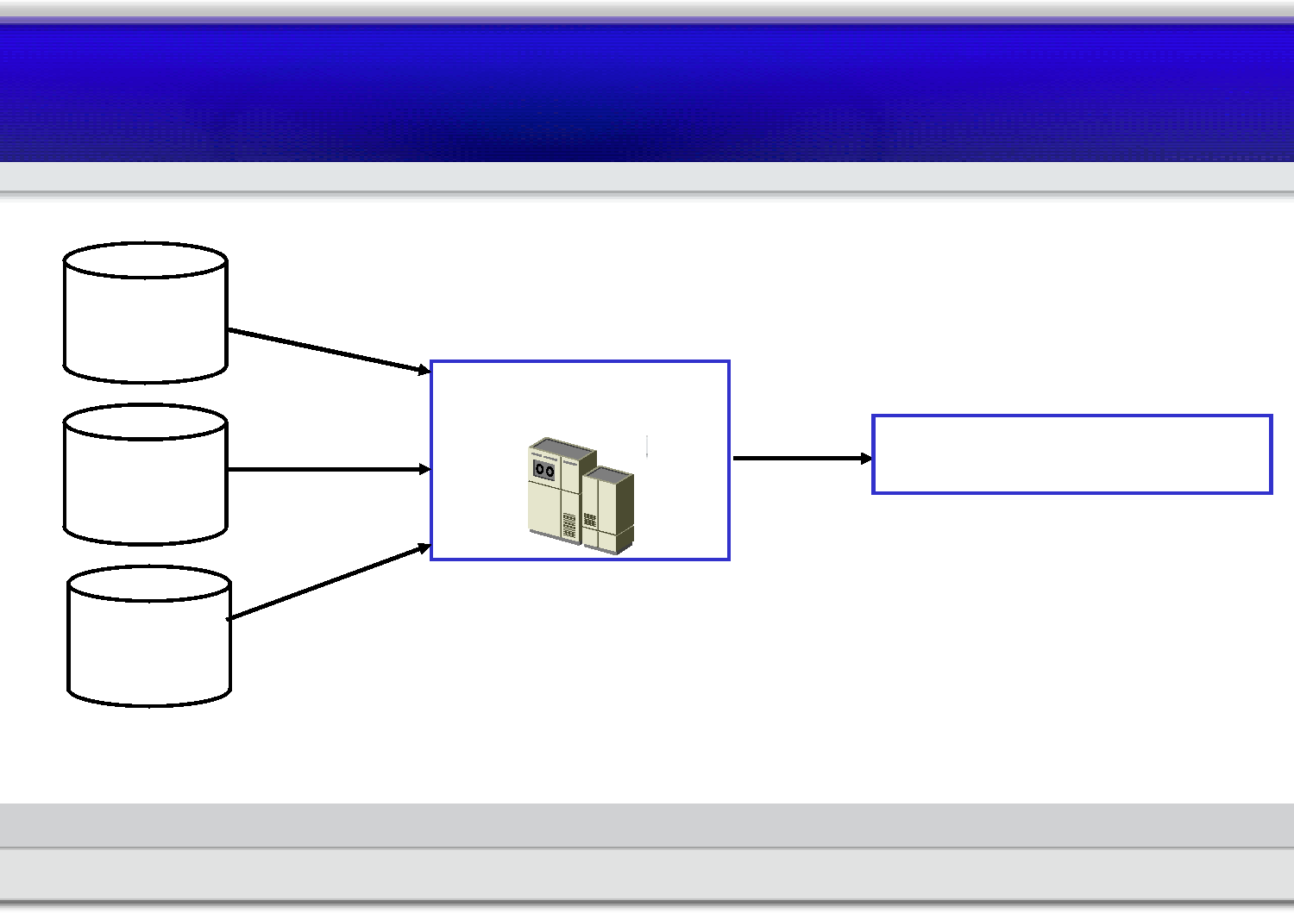
Predictive Analytics:
Predictive Modeling
Customer
profiles
Data mining
Prediction model
Customer
histories
Campaign
histories

Slide 10

Fine-Tuned Models for Your Business
Prediction model created automatically from your data
According to your:
Product
Prediction goal
Business model
Customer base
Specialized for your business

Slide 11


Predictive Insight for Marketing
Prediction model
Prospective campaign
Predicted response
Customer
profile
Customer
history

Slide 12


Taking Business Action
 |  | Business Logic |  | Business action: Mail a solicitation Suggest a cross-sell option Retain with a promotion
Predicted response

Slide 13

Response Modeling for Direct Marketing
Lower campaign costs and increase response rates
Make campaigns more targeted and more selective
Identify segments five or more times as responsive
Achieve 80% of responses with just 40% of mailing
Increase campaign ROI & profitability

Slide 14
Predictors: Building Blocks for Models
recency – How recent was the last purchase?
personal income – How much to spend?
Combine predictors for better rankings
recency + personal income
2*recency + personal income

Slide 15
Predictive Models Score Each Customer
Each customer is scored with a response probability
The customers are listed in order of prediction score
The highest-scoring customers are targeted first
ID number: | Name: | Score: | Response:
429 | J. Johnson | 35% | Yes ©
528 | S. Brown | 31% | No ®
256 | C. Jackson | 22% | Yes ©
674 | K. Towns | 14% | No ®

Slide 16
Applications of Predictive Analytics
Response Modeling Attrition Prediction Customer Valuation
Which prospective Which current What each customer
customers are customers are does in between.
coming. going.

Slide 17
Specific Example Applications
Response Modeling Attrition Prediction Customer Valuation
e-Commerce: Increase online ad take-rates by 28% | Telecom: Increase retention campaign efficiency by 300%; reduce churn 3% and recover $3.8 million. | Pharmaceutical: Invest in health providers most likely to convert prescriptions in the long-term.

Slide 18
Applications of Predictive Analytics
Response Modeling Attrition Prediction Customer Valuation
Direct marketing Acquisition Conversion Market optimization Promotion targeting Cross-selling Up-selling | Churn reduction Customer retention Customer renewal | Hit-and-run prediction Present lifetime value First year revenue

Slide 19
Customer Retention with Attrition Prediction
Customer acquisition is more expensive than retention.
Retention campaigns are targeted with attrition models.
Small improvements in retention generate great returns:
Decreasing churn from 10% to 5% increases net present value by 75%.*
When monthly churn is high, reducing it by 3% can increase growth 12%.
Plus the compounding effect.
This translates to over $500,000 annually for a monthly online subscription service with 200,000 customers.
*The Loyalty Effect, by Reichheld & Teal

Slide 20
Retention Model: Business Rules
If the customer is rural,
and her monthly usage is high,
then the customer will probably renew.

Slide 21

The “Bad” News
Predictive analytics is a business activity,
not an IT activity.

Slide 22
The Mining Business Process
Wholly collaborative process
Driven by business needs and marketing insight
Ensure actionable results
Within your organization's operational framework
Greatest impact within your business model

Slide 23
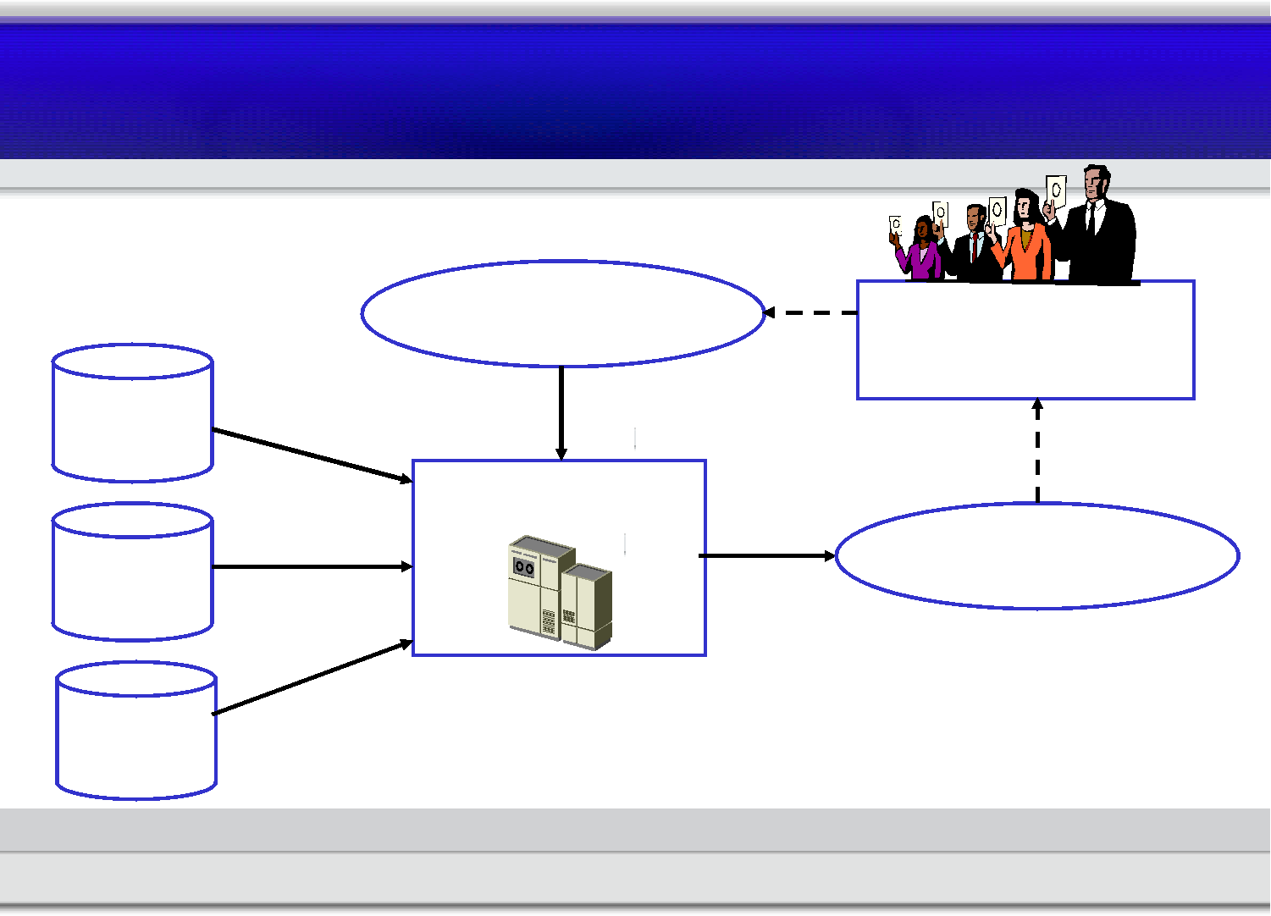
Analytics Process for Customer Prediction
Prediction goal Evaluation with
business expertise
Customer
profiles
Data mining
Customer
histories
Prediction model
Campaign
histories

Slide 24

Predictive Analytics: Summary
Actionable predictions for each customer
Tactical deployment yields strategic results
Requires a business process, driven by
business pragmatics and business needs

Slide 25
Closing Data Mining Puns
Mine your own business!
What's mined is yours!

